Slide 1
IBM Project
CIFAR-10 Image Classification using K-Nearest Neighbors
A Machine Learning Project
Amitabh Ranjan
Brainware University

Slide 2
Problem Statement & Objective
Problem: How can we build a model to automatically identify objects in images?
Dataset: We will use the CIFAR-10 dataset, which consists of 60,000 32x32 pixel images across 10 classes (e.g., car, cat, dog). https://kaggle.com/competitions/cifar-10
Objective: To build an image classification model that can accurately predict the class of an image it has never seen before. We will use the K-Nearest Neighbors (KNN) algorithm to achieve this.

Slide 3
The KNN Algorithm
What is KNN?: It's a simple, supervised machine learning algorithm.
How it Works: KNN classifies a new data point based on the majority class of its 'k' nearest neighbors.
Key components:
K: The number of neighbors to consider. Choosing the right k is crucial.
Distance Metric: The function used to measure the "distance" or similarity between data points (e.g., images).

Slide 4
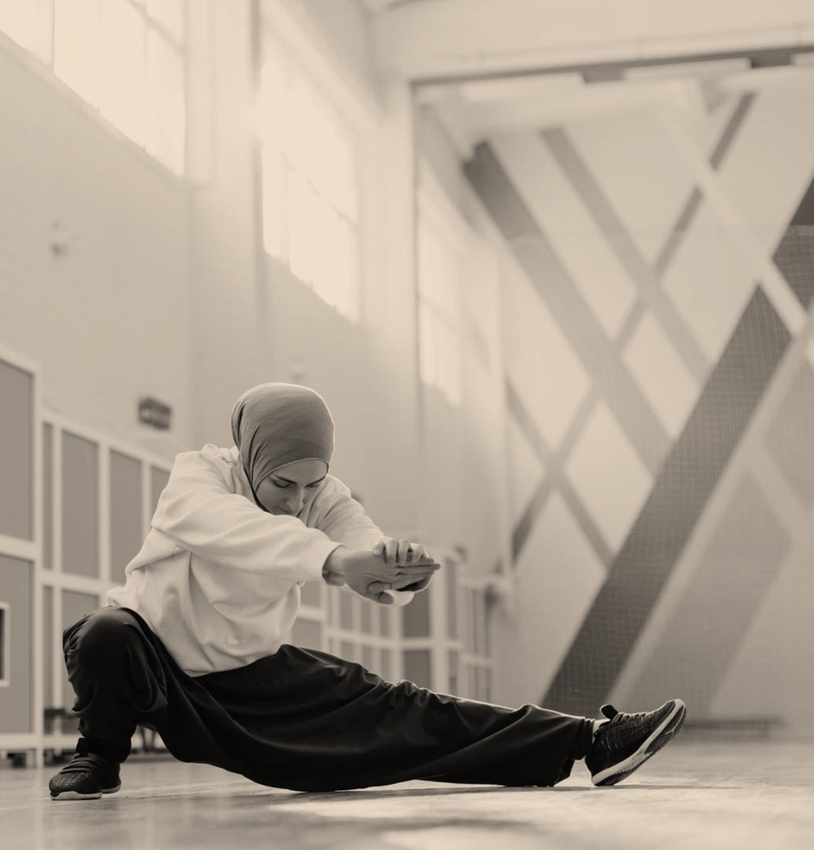
Data Preparation & Methodology
Data Source: CIFAR-10 dataset in a CSV file.
Key Preprocessing Steps:
Sampling: We took a balanced sample of 500 images per class to ensure a representative dataset.
Splitting: The dataset was split into training (80%) and testing (20%) sets.
Our Experiment: We ran a series of experiments to evaluate the KNN model using:
Different k values: [1, 3, 5, 7]
Different distance metrics: Euclidean, Manhattan, and Cosine.

Slide 5
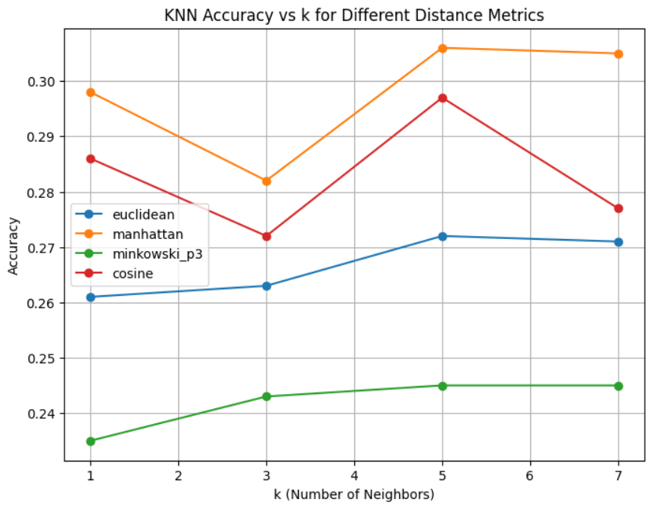
Accuracy vs. K
Summary of Findings: This slide shows how the model's overall accuracy changes with different k values for each distance metric.
Analysis:
Point out the distance metric and k value that achieved the highest accuracy.

Slide 6
Conclusion
In my experiment, the K-Nearest Neighbors (KNN) model achieved a peak accuracy of roughly 30.60% using a Manhattan distance metric and a k value of 5 .
The output also shows that while k=5 was best, the accuracy for k=1 (0.2980) and k=7 (0.3050) were very close, suggesting a small neighborhood is most effective for this problem.
While this is a solid start, KNN has limitations with high-dimensional data like images, which is why we saw some classification errors. The model struggled most with visually similar classes, as shown in the confusion matrix.

Slide 7
THANK YOU
Questions?
I don’t Wana Answer them😅

